Slide 1
ASP.Net Core –Creating web pages with MVC controllers
Kamal Beydoun
Lebanese University – Faculty of Sciences I
Kamal.beydoun@ul.edu.lb

Slide 2
MvcMiddleware
It serves as the main entry point for users to interact with your app.
It typically takes one of two forms
An HTML web application, designed for direct use by users.
An API designed for consumption by another machine or in code : backend server processes, to a mobile app, or to a client framework for building single page applications (SPAs).
It can serve data in machine-readable formats such as JSON or XML, instead of the human-focused HTML output.
Notes:
In this chapter, I’ll try to prepare you for each of the upcoming topics, but you may find that some of the behavior feels a bit like magic at this stage. Try not to become too concerned with exactly how all the pieces tie together; focus on the specific concepts being addressed. It should all become clear as we cover the associated details in the remainder of this first part of the book.

Slide 3
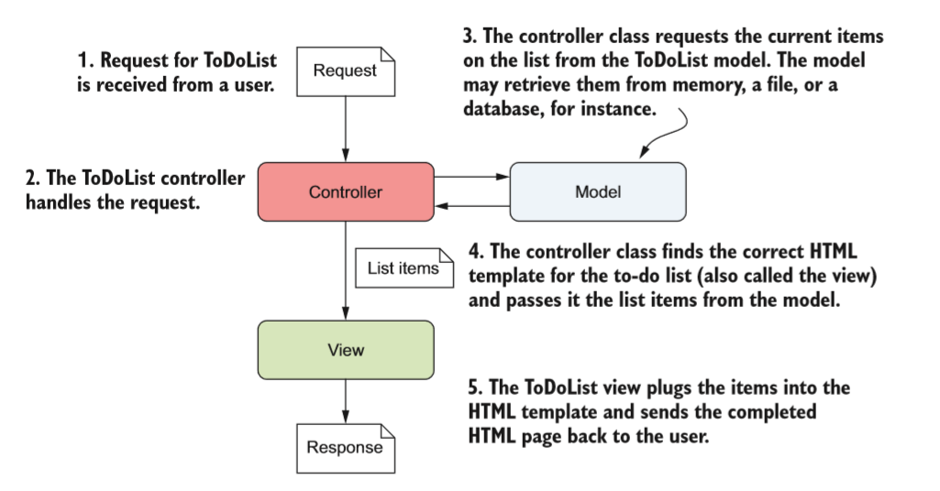
MVC
Fundamentally MVC pattern aims to separate the management and manipulation of data from its visual representation.

Slide 4
MVC
In general, three components make up the MVC design pattern:
Model—The data that needs to be displayed, the state of the application.
View—The template that displays the data provided by the model.
Controller—Updates the model and selects the appropriate view.

Slide 5
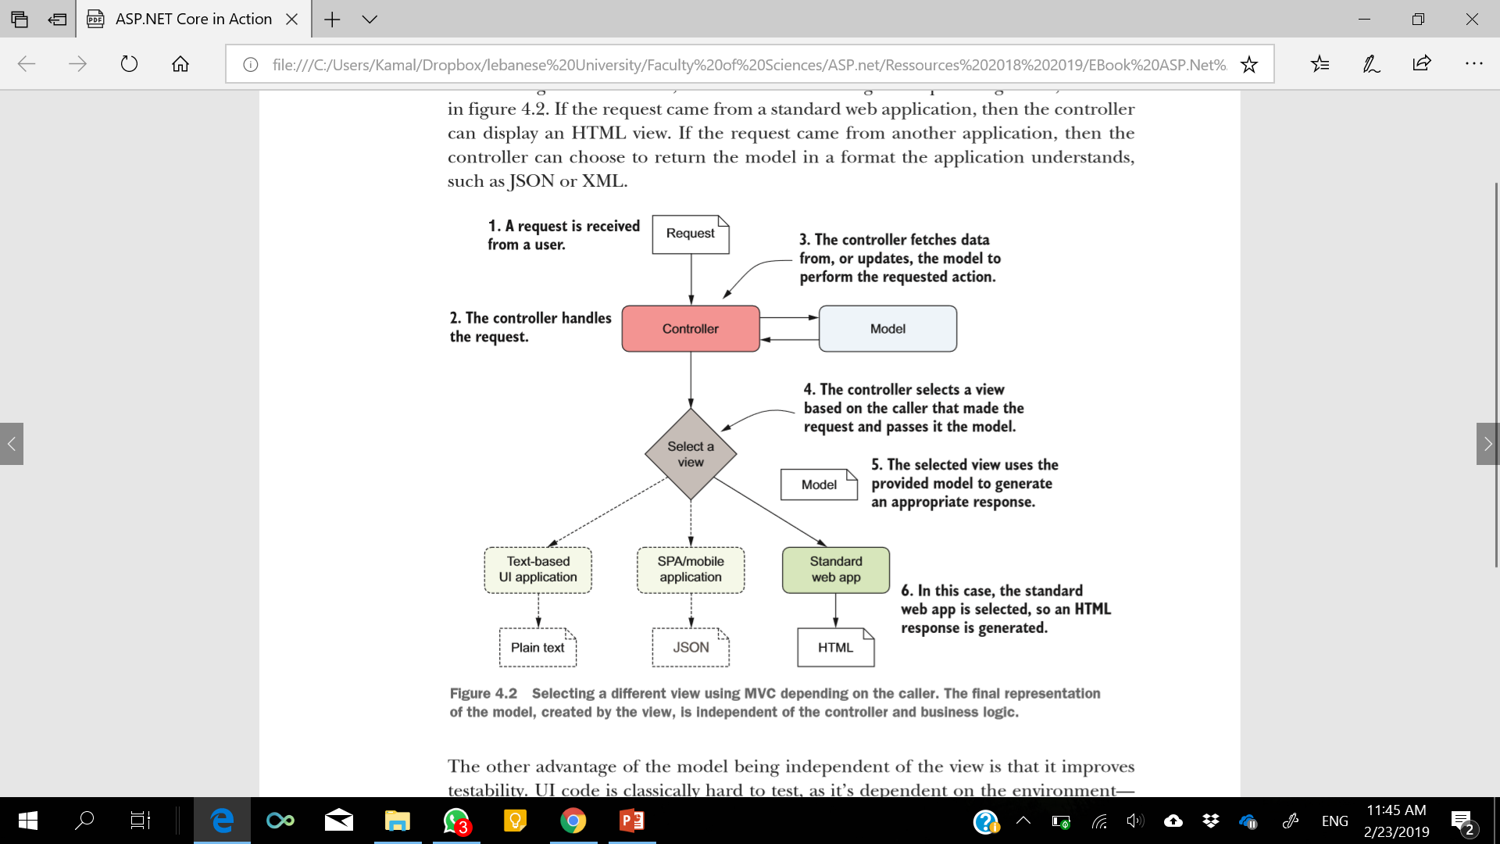
MVC : Order of events
Notes:
Alternatively, if you’re building an app with real-time functionality, you’ll probably want to consider using WebSockets instead of traditional HTTP requests. The WebSockets protocol allows high-performance two-way communication between a server and a client, but they make some things more complicated. You can use WebSockets with ASP.NET Core, but you’ll need to handle things such as connection dropouts, server scaling issues, and old browsers yourself.

Slide 6
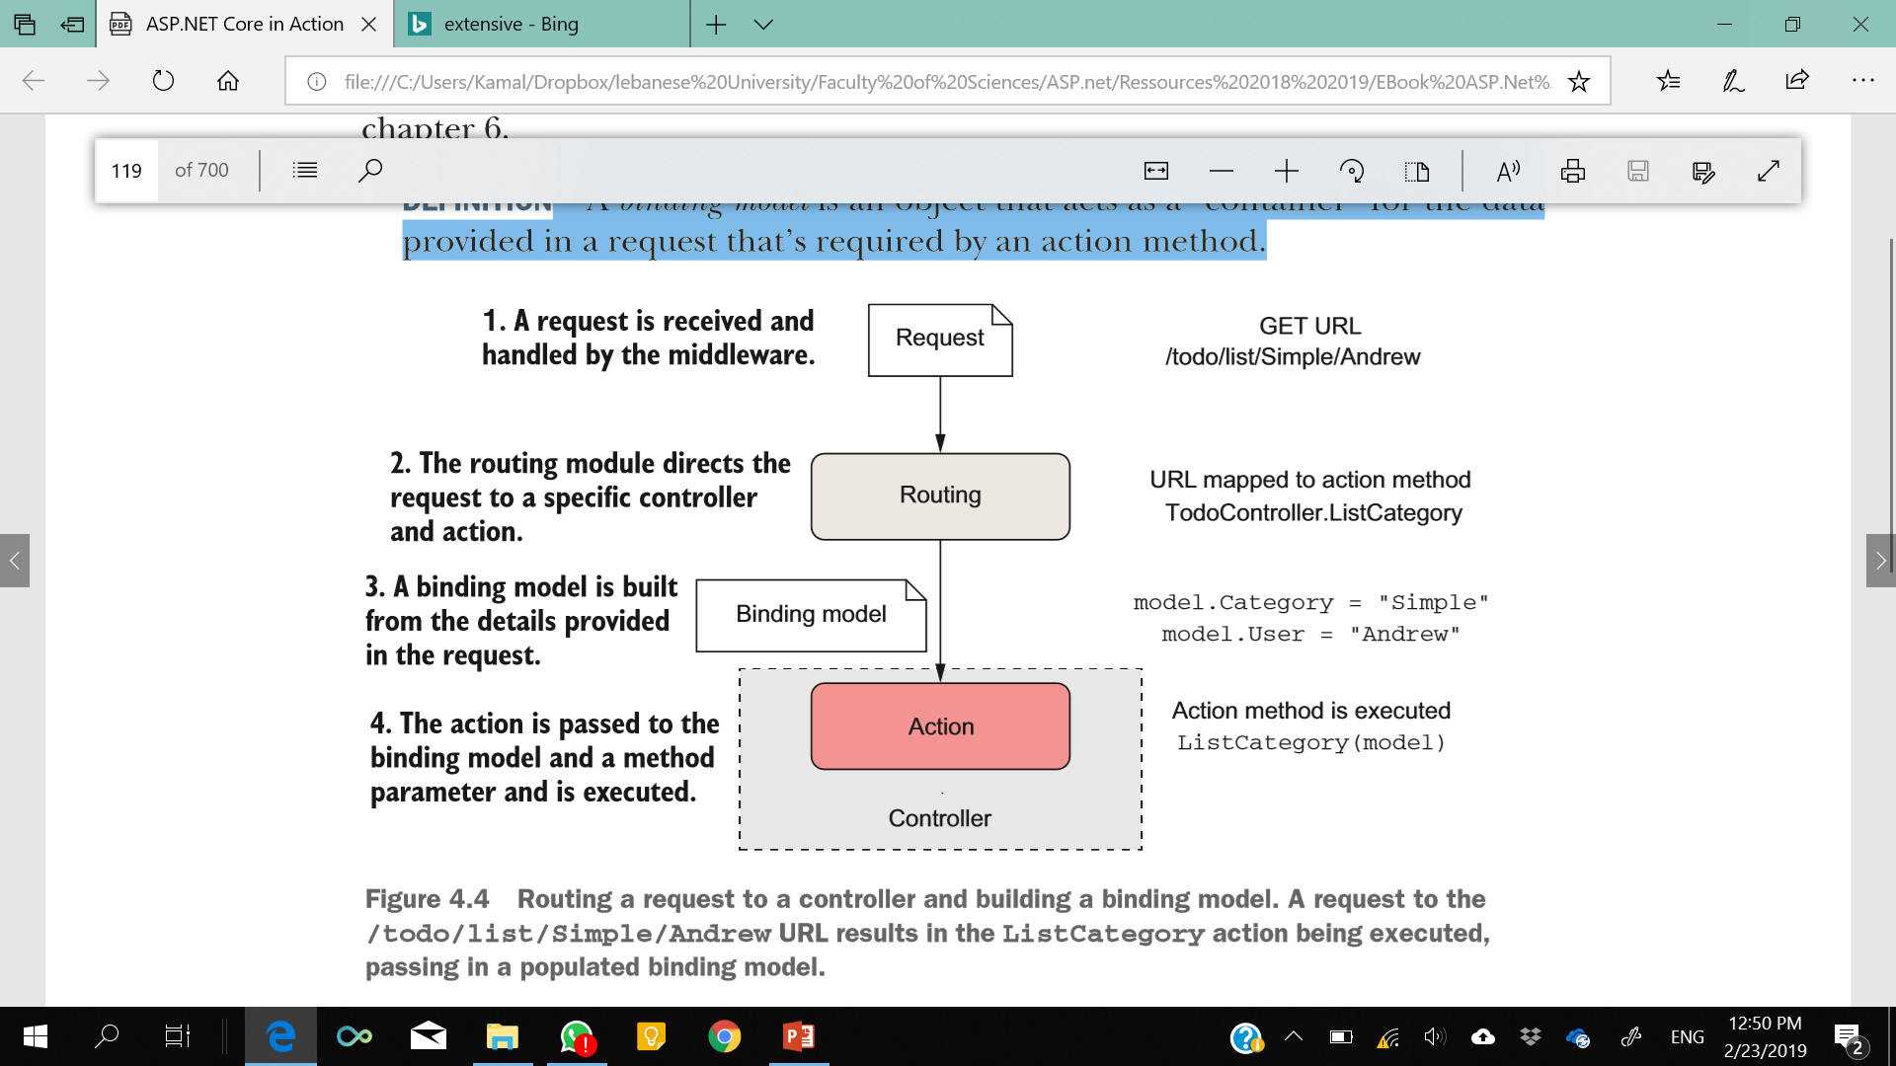
Directing a Request To a Controller and Building a Binding Model
An action (or action method) is a method that runs in response to a request.
A controller is a class that contains a number of logically grouped action methods.
A binding model is an object that acts as a “container” for the data provided in a request that’s required by an action method.
Notes:
The first step when the MvcMiddleware receives a request is routing the request to an appropriate controller.
If you’re looking at the list of items assigned to the user “Andrew” with a category of “Simple,” you’d make a request to the /todo/list/Simple/Andrew URL.
Routing takes the path of the request, /todo/list/Simple/Andrew, and maps it against a preregistered list of patterns.
These patterns match a path to a single controller class and action method.
In this case, the binding model contains two properties: Category, which is “bound” to the "Simple" value, and the User property, which is bound to the "Andrew" value. These values are provided in the request URL’s path and are used to populate a binding model of the TodoModel type.

Slide 7
Executing an action using the application model
The role of an action method in the controller is to coordinate the generation of a response to the request it’s handling.
It validates that the data contained in the binding model provided is valid for the request.
It invokes the appropriate actions on the application model.
It selects an appropriate response to generate based on the response from the application model.

Slide 8
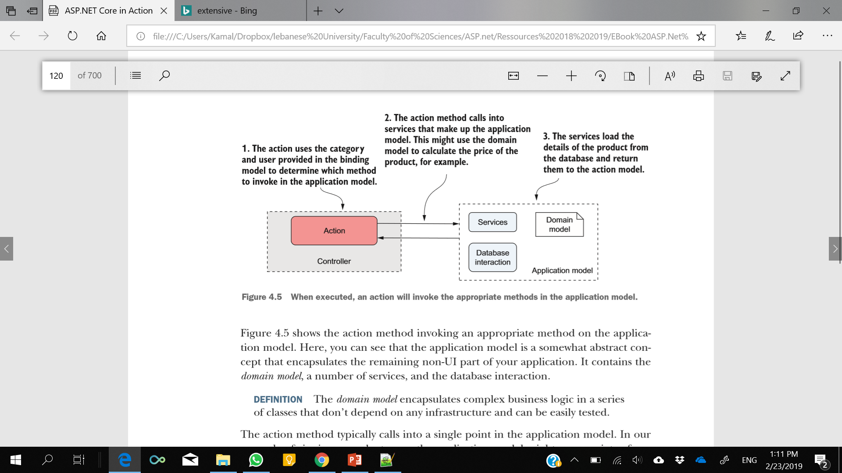
Action Method
The domain model encapsulates complex business logic in a series of classes that don’t depend on any infrastructure and can be easily tested.
Notes:
Here, you can see that the application model is a somewhat abstract concept that encapsulates the remaining non-UI part of your application. It contains the domain model, a number of services, and the database interaction.
The domain model encapsulates complex business logic in a series of classes that don’t depend on any infrastructure and can be easily tested.

Slide 9
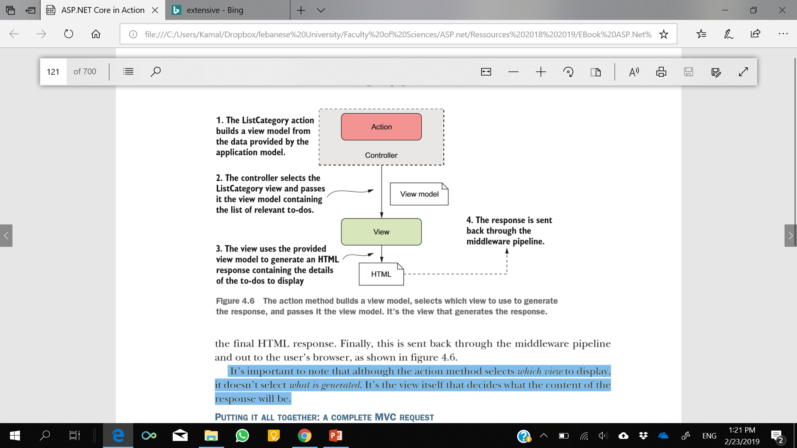
Generating A Response Using A View Model
A view model is a simple object that contains data required by the view to render a UI.
Notes:
It’s important to note that although the action method selects which view to display, it doesn’t select what is generated. It’s the view itself that decides what the content of the response will be.

Slide 10
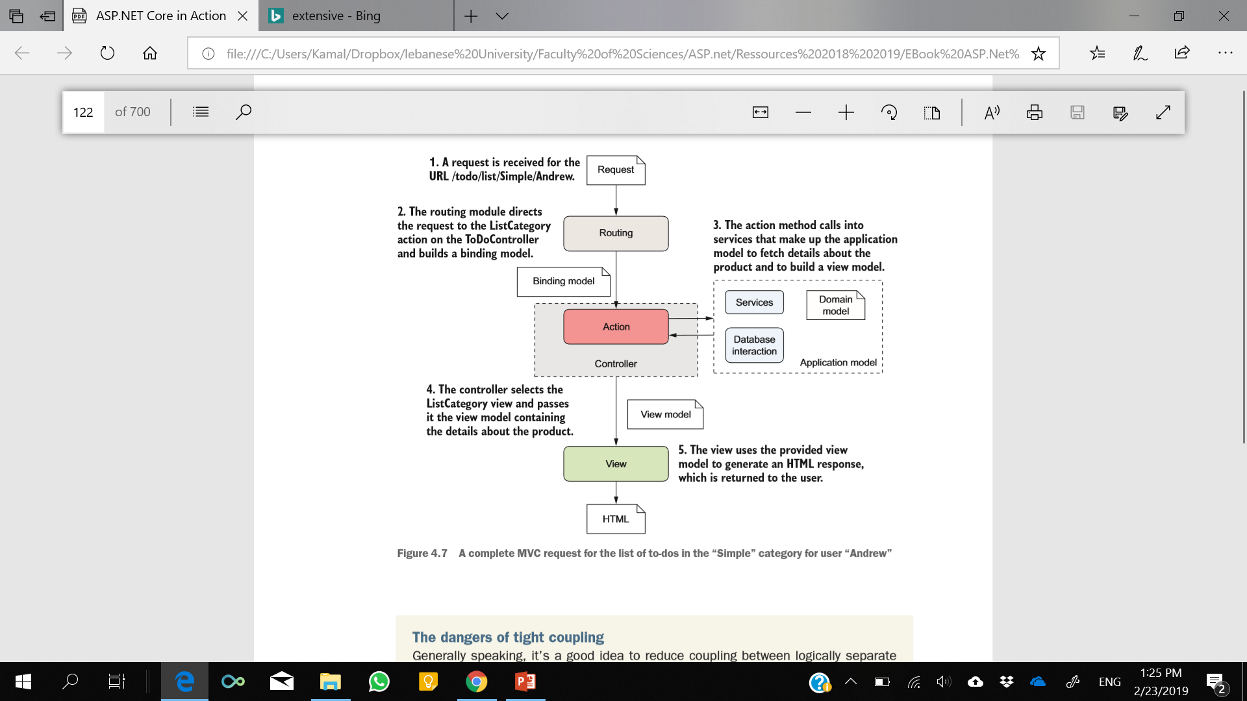
A COMPLETE MVC REQUEST
Notes:
By now, you might be thinking this whole process seems rather convoluted—so many steps to display some HTML! Why not allow the application model to create the view directly, rather than having to go on a dance back and forth with the controller/action method? The key benefit throughout this process is the separation of concerns:
○ The view is responsible only for taking some data and generating HTML.
○ The application model is responsible only for executing the required business logic.
○ The controller is responsible only for validating the incoming request and selecting the appropriate view to display, based on the output of the application model.

Slide 11
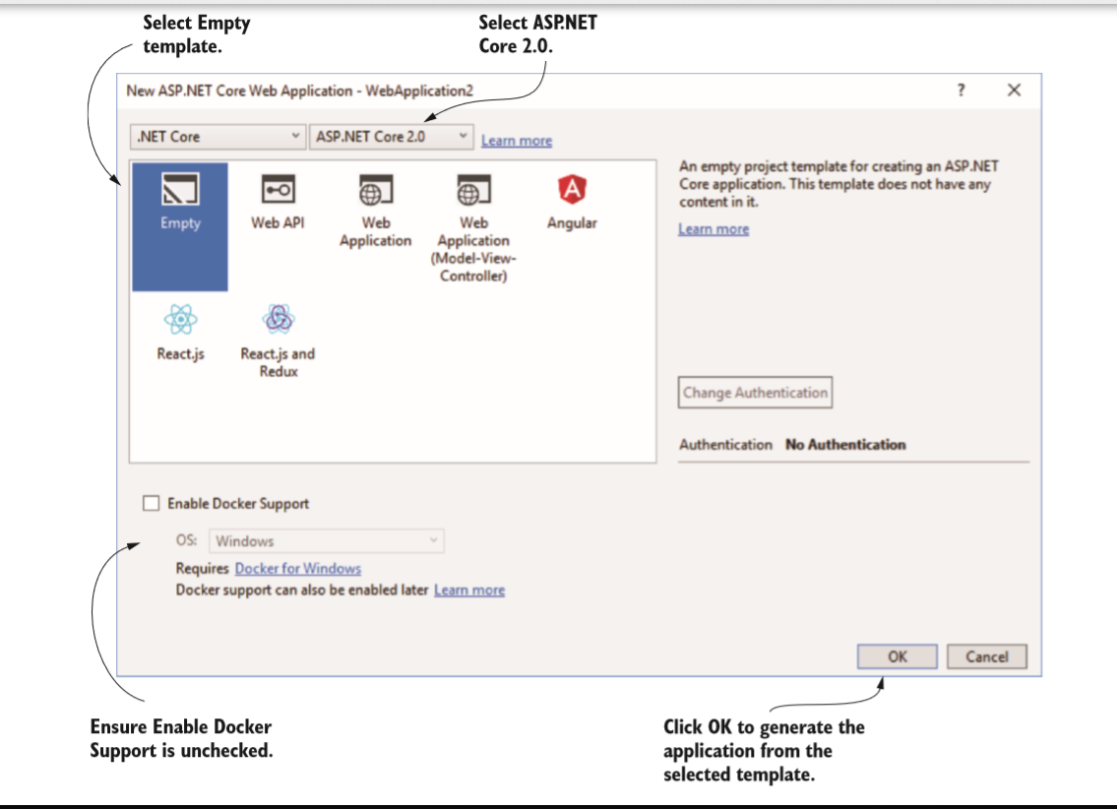
Adding the MvcMiddleware to your application

Slide 12
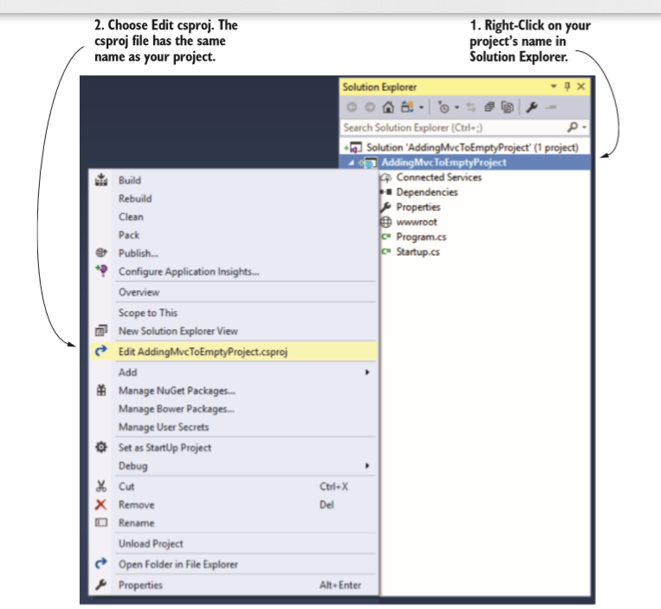
Notes:
TO DO with students.
The default ASP.NET Core 2.0 template references the Microsoft.AspNetCore .All metapackage in its csproj file:
<PackageReference Include="Microsoft.AspNetCore.All" Version="2.0.0" /> This includes all of the packages in ASP.NET Core, so you won’t need to reference any others.1

Slide 13
In Startup.cs
public void ConfigureServices(IServiceCollection services) {
services.AddMvc();
}
public void Configure(IApplicationBuilder app, IHostingEnvironment env) { app.UseMvc(routes => {
} routes.MapRoute( name: "default", template: "{controller=Home}/{action=Index}/{id?}"); });
Notes:
As part of this call, the routes that are used to map URL paths to controllers and actions are registered. We used the default convention here, but you can easily customize these to match your requirements.

Slide 14
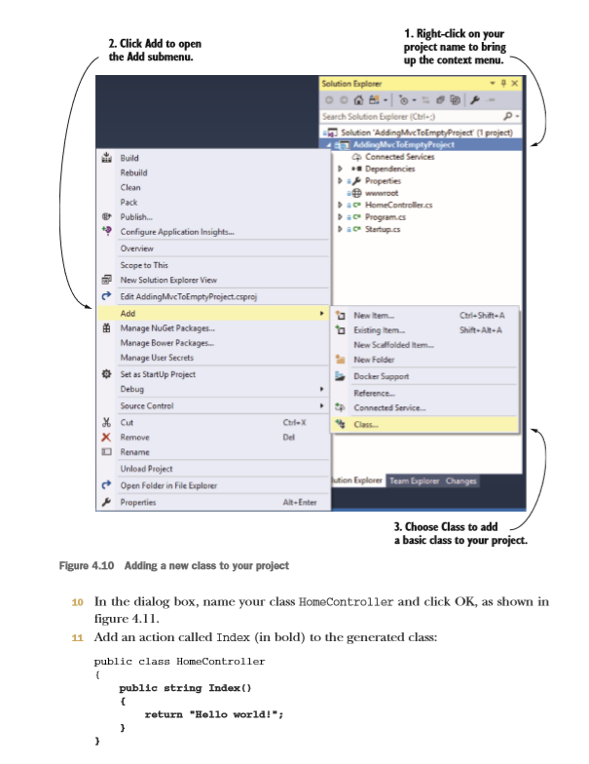
Notes:
NOTE You can run your project by pressing F5 from within Visual Studio (or by calling dotnet run at the command line from the project folder). This will restore any referenced NuGet packages, build your project, and start your application. Visual Studio will automatically open a browser window to access your application’s homepage.

Slide 15
What makes a controller a controller?
Controllers in ASP.NET Core are classes that contain a logical grouping of action methods.
MVC or Web API controllers are discovered and used by the MvcMiddleware as long as they are instantiable (they have a public constructor, aren’t static, and aren’t abstract) and either:
Have a name ending in “Controller,” for example HomeController
Inherit from the Controller or ControllerBase class (or a class that inherits from these)

Slide 16
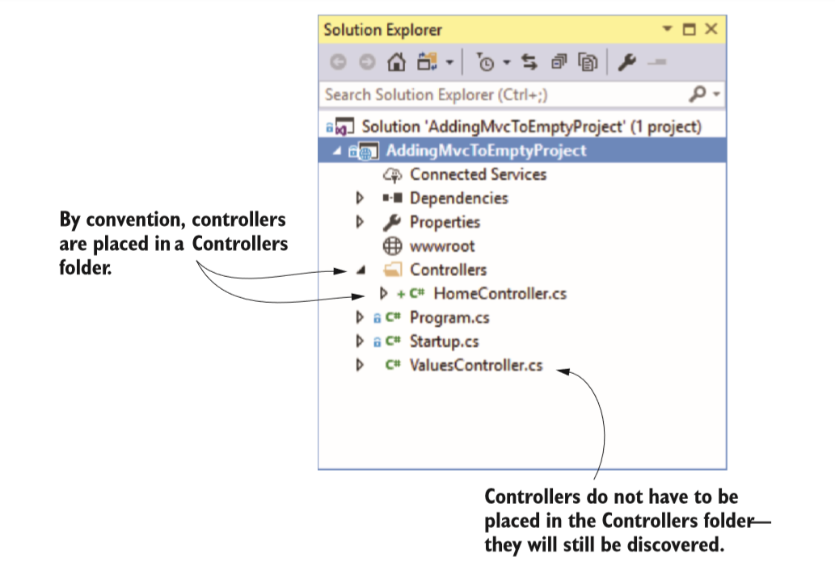
Another common convention is to place all your controller files in a Controllers subfolder in your project

Slide 17
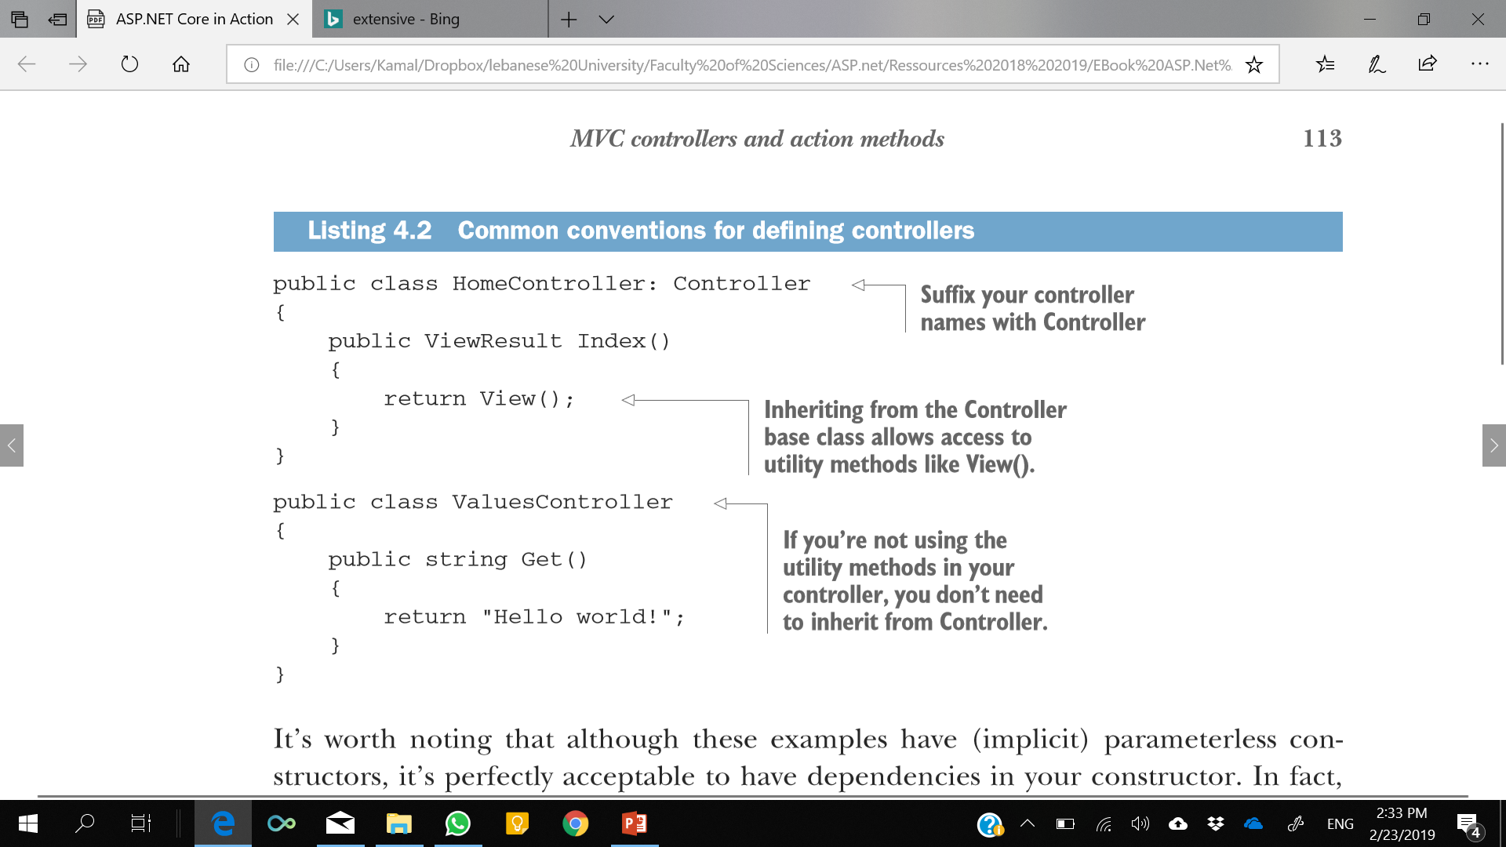

Slide 18
MVC controllers and action methods
Any public method on a controller acts as an action method, and so can be invoked by a client.
The responsibility of an action method is generally threefold:
Confirm the incoming request is valid.
Invoke the appropriate business logic corresponding to the incoming request.
Choose the appropriate kind of response to return.
Notes:
In the design pattern, the controller receives a request and is the entry point for UI generation. In ASP.NET Core, the entry point is an action method that resides in a controller. An action, or action method, is a method that runs in response to a request.
An action doesn’t need to perform all of these actions, but at the very least it must choose the kind of response to return. For a traditional MVC application that’s returning HTML to a browser, action methods will typically return either a ViewResult that the MvcMiddleware will use to generate an HTML response, or a RedirectResult, which indicates the user should be redirected to a different page in your application.
It’s important to realize that an action method doesn’t generate a response directly; it selects the type of response and prepares the data for it. For example, returning a ViewResult doesn’t generate any HTML at that point, it indicates which view template to use and the view model it will have access to. This is in keeping with the MVC design pattern in which it’s the view that generates the response, not the controller.
It’s also worth bearing in mind that action methods should generally not be performing business logic directly. Instead, they should call appropriate services in the application model to handle requests.

Slide 19
Accepting parameters to action methods
Some requests made to action methods will require additional values with details about the request.
Username / Password
Data of application form
Notes:
If the request is for a search page, the request might contain details of the search term and the page number they’re looking at. If the request is posting a form to your application, for example a user logging in with their username and password, then those values must be contained in the request.
The request may contain additional values from a variety of different sources. They could be part of the URL, the query string, headers, or in the body of the request itself. The middleware will extract values from each of these sources and convert them into .NET types.

Slide 20
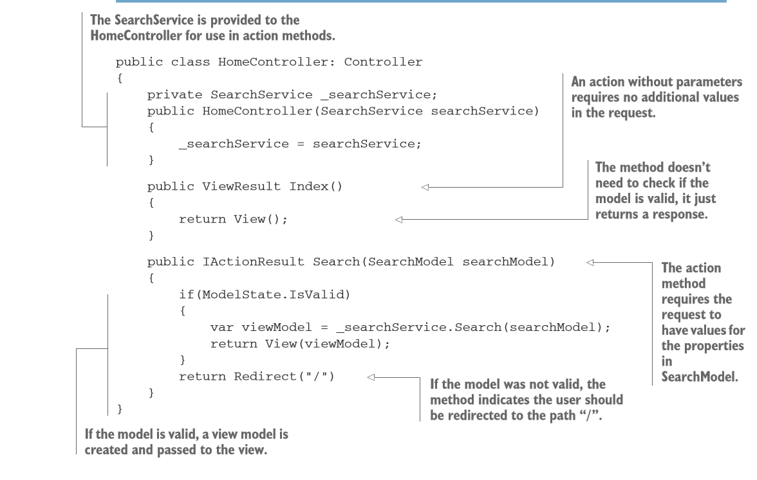
IActionResult returned by an action method, when executed by the MvcMiddleware using the view engine, will generate the response.
Notes:
In this example, the Index action method doesn’t require any parameters, and the method is simple—it returns a view to the user. The Search action method, conversely, accepts a SearchModel object. This could contain multiple different properties that are obtained from the request and are set on the model in a process called model binding. The SearchModel object is often described as a binding model.
When an action method accepts parameters, it should always check that the model provided is valid using ModelState.IsValid. The ModelState property is exposed when you inherit from the base Controller or ControllerBase class and can be used to check that the method parameters are valid.

Slide 21
Using ActionResult
ASP.NET Core has many different types of IActionResult:
ViewResult —Generates an HTML view.
RedirectResult —Sends a 302 HTTP redirect response to automatically send a user to a specified URL.
RedirectToRouteResult —Sends a 302 HTTP redirect response to automatically send a user to another page, where the URL is defined using routing.
FileResult —Returns a file as the response.
ContentResult —Returns a provided string as the response.
StatusCodeResult —Sends a raw HTTP status code as the response, optionally with associated response body content.
NotFoundResult —Sends a raw 404 HTTP status code as the response.

Slide 22
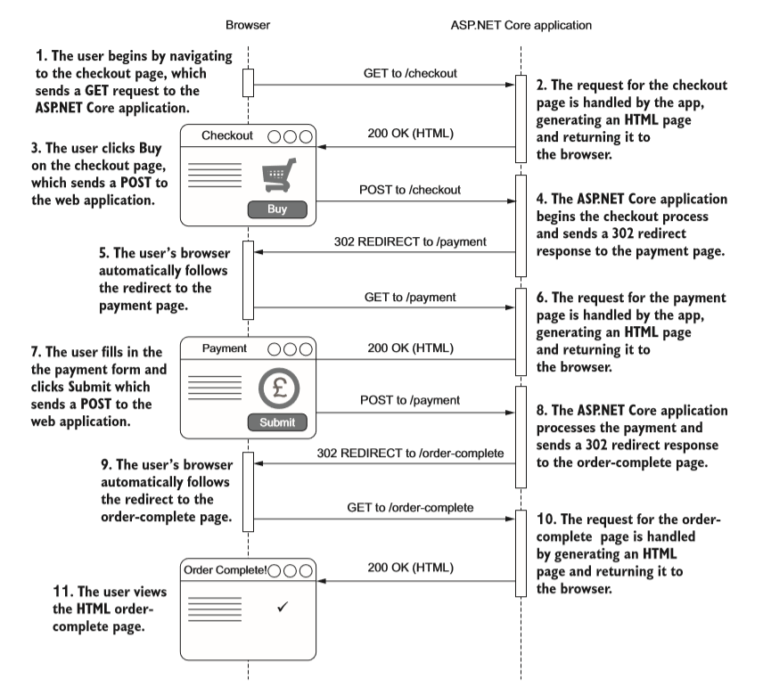
ViewResult and RedirectResult
Notes:
When you’re building a traditional web application and generating HTML, most of the time you’ll be using the ViewResult, which generates an HTML response using Razor (by default). We’ll look at how this happens in detail in chapter 7.

Slide 23
NotFoundResult and StatusCodeResult
If you request a page for viewing a product on an e-commerce application, and that product doesn’t exist, a 404 HTTP status code is returned to the browser and you’ll typically see a “Not found” web page.
The MvcMiddleware can achieve this behavior by returning a NotFoundResult, which will return a raw 404 HTTP status code.
You could achieve a similar result using the StatusCodeResult and setting the status code returned explicitly to 404.
Notes:
Rawhtml : Wraps HTML markup in an HtmlString instance so that it is interpreted as HTML markup.

Slide 24
Creating ActionResult classes using Helper Method
ActionResult classes can be created and returned using the normal new syntax of C#: return new ViewResult()
If your controller inherits from the base Controller class, we use:
View method to generate an appropriate ViewResult,
Redirect method to generate a RedirectResponse,
NotFound method to generate a NotFoundResult.
Notes:
Most ActionResult classes have a helper method on the base Controller class. They’re typically named Type, and the result generated is called TypeResult. For example, the Content method returns a ContentResult instance.
As discussed earlier, the act of returning an IActionResult doesn’t immediately generate the response—it’s the execution of an IActionResult by the MvcMiddleware, which occurs outside the action method.

Slide 25
Summary
MVC allows for a separation of concerns between the business logic of your application, the data that’s passed around, and the display of data in a response.
Controllers contain a logical grouping of action methods.
ASP.NET Core controllers inherit from either the Controller or ControllerBase class or have a name that ends in controller.
Action methods decide what sort of response to generate; action results handle the generation.
Action methods should generally delegate to services to handle the business logic required by a request, instead of performing the changes themselves. This ensures a clean separation of concerns that aids testing and improves application structure.
Action methods can have parameters whose values are taken from properties of the incoming request.

Slide 26
Summary
When building a traditional web application, you’ll generally use a ViewResult to generate an HTML response.
You can send users to a new URL using a RedirectResult.
The Controller base class exposes many helper methods for creating an ActionResult.
The MVC and Web API infrastructure is unified in ASP.NET Core. The only thing that differentiates a traditional MVC controller from a Web API controller is the data it returns. MVC controllers normally return a ViewResult, whereas Web API controllers typically return data or a StatusCodeResult

